Slide 1
G.H. RAISONI COLLEGE OF ENGINEERING & MANAGEMENT, PUNE
GROUP NUMBER : A3
NAME & ROLL NO :
PRAJWAL BHOYAR ( BCOA07 )
ADITYA BUTLEY ( BCOA08 )
SUMEDH DHOLE ( BCOA14 )
NISHAD JOSHI ( BCOA16 )
Guide & Mentor :
DR. Aniruddha Rumale

Slide 2
Intelligent Video Surveillance using YOLO Object Detection

Slide 3
Index
overview
Problem statement
Goals and objective
Literature survey
Introduction
Difficulties and problems
Application

Slide 4
Overview
A few years ago, the creation of the software and hardware image processing systems was mainly limited to the development of the user interface.
The situation has been significantly changed with the advancement in the technology, computational power and also developers switched to solving the problems of image processing.
the modern world produces gigantic amount of visual data.
There are Many image analysis techniques to analyse and understand this visual information. these methods can automatically recognise and detect object in a image that are potentially important.
The content of the image and videos can be then further processed to extract significant information from the visual information.

Slide 5
Problem Statement
To achieve object detection using YOLO Neural Networks and Convolution Neural Network Algorithm. The aim of object detection is to detect all instances of objects from a known class, such as people, cars, animals or faces in an image.

Slide 6
Goals and Objectives
Object Detection can be used for security purposes
ex: surveillance
For wild life monitoring purposes. To keep a keen eye on animal activities and behaviour
To be used for Industrial inspection
Plays an important role in the field of Robotics
Medical analysis ranging from skin disease detection and cancer detection
Lane detection in autonomous car

Slide 7
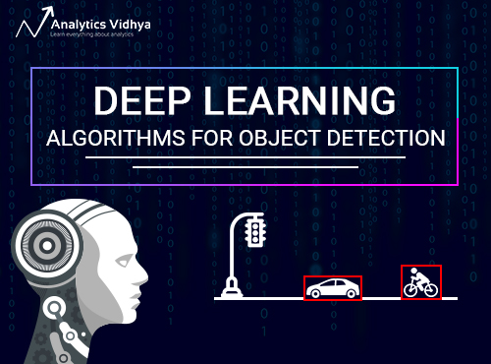
Approaches in deep learning
OverFeat
R-cnn
Fast r-cnn
Yolo
Faster r-cnn
Ssd and r-fcn

Slide 8
Literature survey
S. No | Paper Title | Author Name | Problem Discussed | Algorithm /Technology Used | Advantages/Limitations | Journal /Conference Name
1 | Unified, Real-Time Object Detection | Joseph Redmon Santosh Divvala Ali Farhadi Ross Girshick | YOLO was Proposed | YOLO Convolution Deep Learning | Discussed in further slides
2 | An Incremental Improvement | Joseph Redmon, Ali Farhadi | Making YOLO Algorithm better | Better and faster version of YOLO | Increased Frame processing and capturing small objects

Slide 9
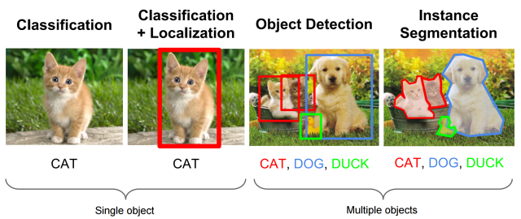
Introduction
The aim of object detection is to detect all instances of objects from a known class, such as people, cars, animals or faces in an image.
The important content in the image are object and their respective location.
Recognition is an important task in image processing and computer vision. A set of known tags can be used to identify what really the object is and help to extract information.

Slide 10
Yolo
You only look once: a simple conventional neural network approach which has both great result and high speed, allowing for the first time real time object detection.
You Only Look Once or YOLO is one of the popular algorithms in object detection used by the researchers around the globe. According to the researchers at Facebook AI Research, the unified architecture of YOLO is extremely fast in manner. The base YOLO model processes images in real-time at 45 frames per second, while the smaller version of the network, Fast YOLO processes an astounding 155 frames per second while still achieving double of other real-time detectors. This algorithm outperforms the other detection methods, including DPM and R-CNN, when generalizing from natural images to other domains like artwork.

Slide 11
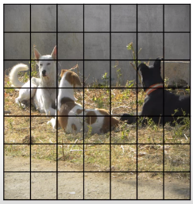
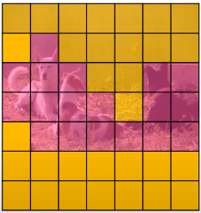
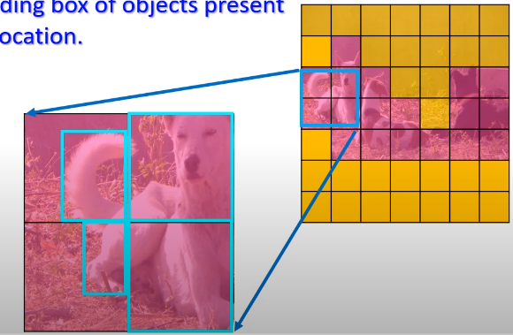

Grid divided into (SxS)
Different classes
Divide the input into a grids of size S x S
Predict a class and a bounding box of objects present in the grid for every grid location
Bounding boxes are estimated

Slide 12
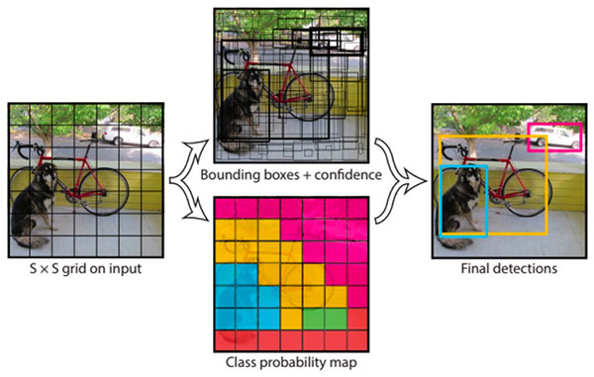

Slide 13
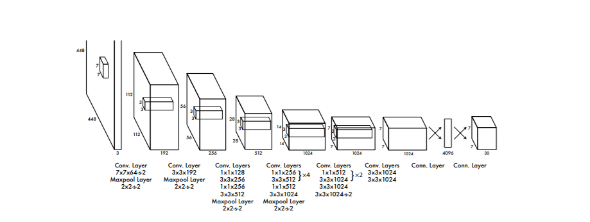
Architecture
Our detection network has 24 convolutional layers followed by 2 fully connected layers. Alternating 1 × 1 convolutional layers reduce the features space from preceding layers. We pretrain the convolutional layers on the ImageNet classification task at half the resolution (224 × 224 input image) and then double the resolution for detection.

Slide 14
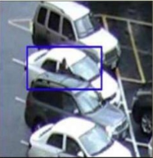


Difficulties and problems
illumination - The lightning conditions may differ during the course of the day. also the weather condition may affect the lightning in an image
Positioning - the change in position must not affect object detection.
Rotation – the image can be in rotated form.
Mirroring – the mirrored image must be recognised.
Occlusion – the condition when the object in an image is not completely visible is referred to as occlusion.
Scale – change in size must not affect recognition.

Slide 15
Applications
Biometric recognition
Wild life monitoring
Surveillance
Industrial inspection
Robotics
Medical analysis
Lane detection in autonomous car
Security

Slide 16
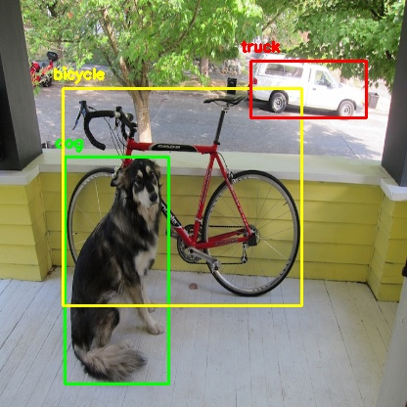
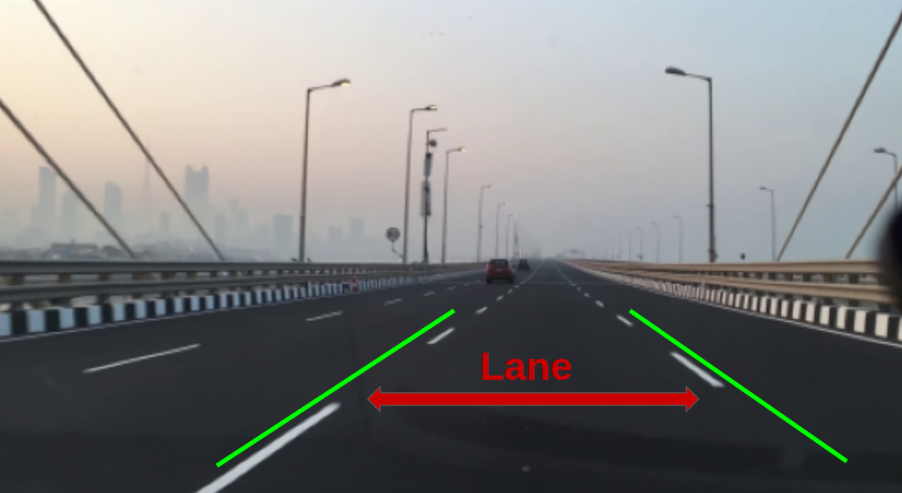
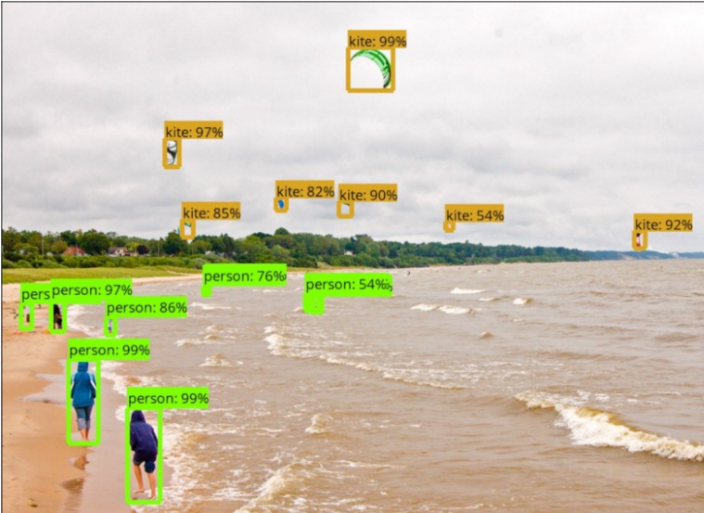
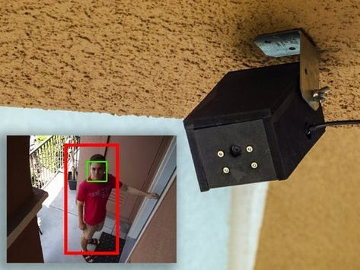

Slide 17
Advantages and disadvantages of YOLO
Advantages:
YOLO is orders of magnitude faster(45 frames per second) than other object detection algorithms.
A smaller version of the network, Fast YOLO, processes an astounding 155 frames per second while still achieving double the mAP of other real-time detectors. Compared to state-of-the-art detection systems, YOLO makes more localization errors but is far less likely to predict false detections where nothing exists.
Finally, YOLO learns very general representations of objects. It outperforms all other detection methods, including DPM and RCNN, by a wide margin when generalizing from natural images to artwork on both the Picasso Dataset and the PeopleArt Dataset.

Slide 18
Limitations:
The limitation of YOLO algorithm is that it struggles with small objects within the image, for example, it might have difficulties in detecting a flock of birds. This is due to the spatial constraints of the algorithm.
YOLO imposes strong spatial constraints on bounding box predictions since each grid cell only predicts two boxes and can only have one class. This spatial constraint limits the number of nearby objects that our model can predict.
Our model struggles with small objects that appear in groups, such as flocks of birds. Since our model learns to predict bounding boxes from data, it struggles to generalize to objects in new or unusual aspect ratios or configurations.
Our model also uses relatively coarse features for predicting bounding boxes since our architecture has multiple downsampling layers from the input image

Slide 19
Hardware and Software
Hardware:
High Processing Power is needed. Intel i5+ 8th + generation
For computational resources GDDR5 Ram Graphics card is need least 4GB
Software:
TensorFlow
Anaconda
Python
Flask

Slide 20
Thank you

